Slide 1


Welcome to imademethink
Cucumber tutorials for BDD with Java

Slide 2
Agenda
What is it?
What is Gherkin?
Keywords used in Gherkin
Feature file
Step, Step Definition, Step Implementation
Parameterization (int, string, dataTable, examples)
Jar files, Maven dependency
(Maven based) Runner file and annotations
Parallel test execution
Reporting (normal, pass/ fail)
Reporting (advanced with graphs)
Gherkin example in other languages

Slide 3
What is it?
It is a testing framework which is used Behaviour Driven Development (BDD) based testing.
Using Cucumber we can define application behaviour in plain English text.
It uses Gherkin language.
What is Gherkin?
Gherkin is the language that Cucumber understands.
It is a Business Readable, Domain Specific Language that lets you describe software's behaviour without detailing how that behaviour is implemented.
Gherkin serves two purposes — documentation and automated tests.

Slide 4
Keywords used in Cucumber
Given
When
And
Then
But
Scenario
Scenario Outline
Background
Examples, Data Table
Feature

Slide 5
Feature file
A file with .feature extension
A place user can write different scenario, Gherkin plain English statements in short called steps
Example
Sample project structure (Maven based)
Step, Step Definition, Step Implementation
Step – Smallest individual action by user written in Gherkin
Step Definition – Actual testing implementation for each step i.e. actual automation code pertaining to each step (usually a call to a method in Java)
Step Implementation – Detailed automation code with many small, small pieces of code to achieve particular functionality
Example

Slide 6
Parameterization
Passing parameter from feature file
Numeric (Int/ Float)
String
Using Examples, DataTable
Receiving/ parsing parameters in Java
Automatically generate step definition code

Slide 7
Junit/ TestNG .jar file
Maven dependency
Refer to https://mvnrepository.com/artifact/info.cukes/cucumber-java/1.2.5
<dependency>
<groupId>info.cukes</groupId>
<artifactId>cucumber-java</artifactId>
<version><<check latest version from above link>></version>
</dependency>
Download .jar file and import as external jar for non Maven projects

Slide 8
(Maven based) Runner file & CucumberOptions
Example runner file (.java) and .pom file linking
@CucumberOptions:
Ref - https://github.com/cucumber/cucumber-eclipse
Import statements
import org.junit.runner.RunWith;
import cucumber.junit.Cucumber;
@RunWith(Cucumber.class)
@CucumberOptions{…}
features = {“<<path to relevant feature files folder>>“,””,”…”}
glue = “<<path to package to look for step definition>>“
strict = true/ false
True = To fail test case if step is not implemented
False = To pass test case if step is not implemented
monochrome = true/ false
Colored output in CI/ CD environment e.g. Jenkins
plugin = {"pretty","html:target/cucumber"}
format = {"pretty", "html:target/cucumber“}

Slide 9
(Maven based) Runner file and annotations
@CucumberOptions{…}
tags = {@tag1, ~@tag2}
AND/ OR combination possible to filter specific test scenarios
Passing tags from Eclipse (maven) run configuration
Passing tags from command line
-Dcucumber.options="@tag1“
Parallel Test Execution
For running tests in parallel use following approach:
Multiple runner files and using maven-surefire-plugin
<forkCount>10</forkCount>
<reuseForks>true</reuseForks>
<inclide>Runner file combinations</include>

Slide 10
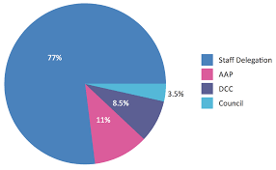
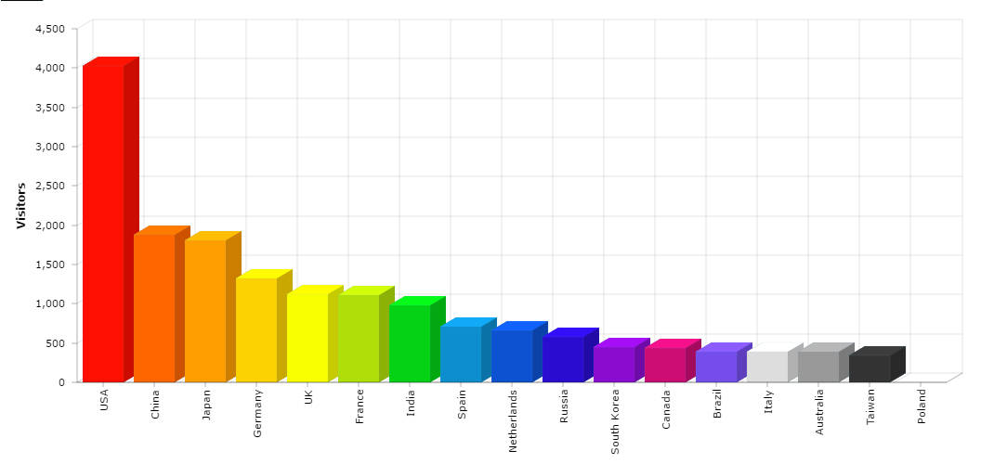
Reporting
Need to add following Cucumber options in runner file
plugin = {"pretty","html:target/cucumber"}
Sample test report using index.html
Advanced Reporting
Results shown in graphical format
Use additional plugin in pom file
maven-cucumber-reporting
It works by generating html from the cucumber json report formatter

Slide 11
Other language example
Gherkin supports not only English but many other native languages such as French, Finnish, Indonesian, Hungarian, Hindi, Urdu, Gujarati as well.
Ref: https://github.com/cucumber/cucumber/blob/master/gherkin/gherkin-languages.json

